Slide 1
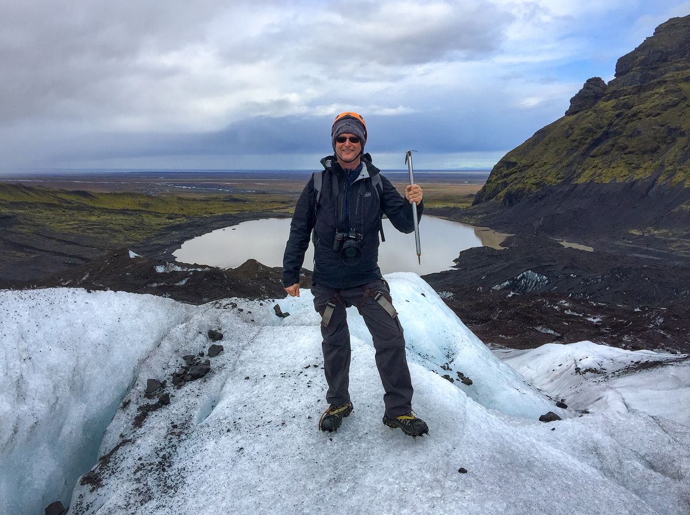
TRAVELS THROUGH ICELAND
Rated R
(topless and inappropriately dressed models, ladies’ undergarments, and inappropriate behavior)

Slide 2
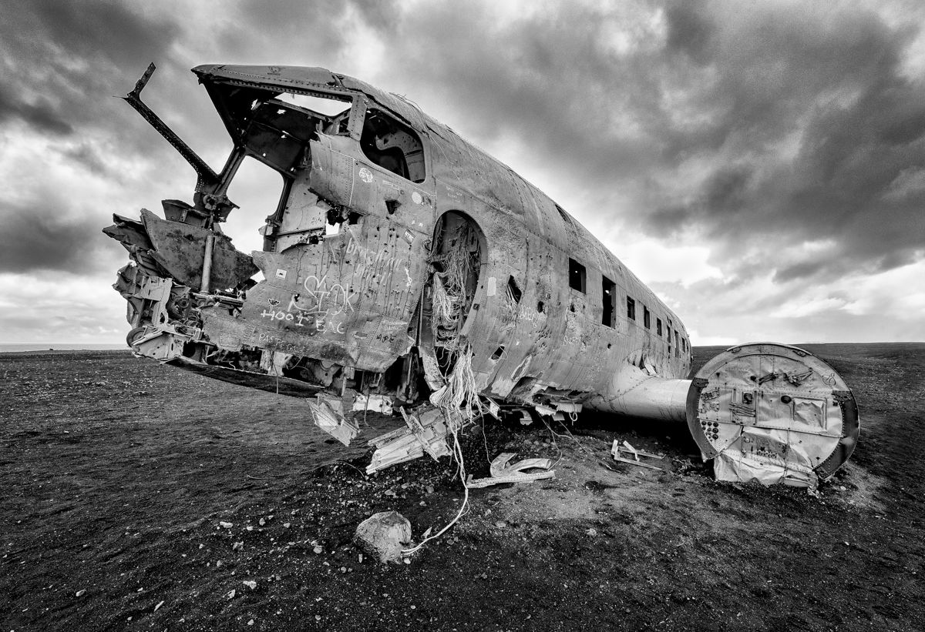
PRACTICALITIES
GETTING THERE
GETTING AROUND
Notes:
Solehimajokull,
Quicker and cheaper than Glacier national park.
Driving 4 wheel drive, insurance (sand and ash), roads main highway, off the beaten track. F-roads.

Slide 3
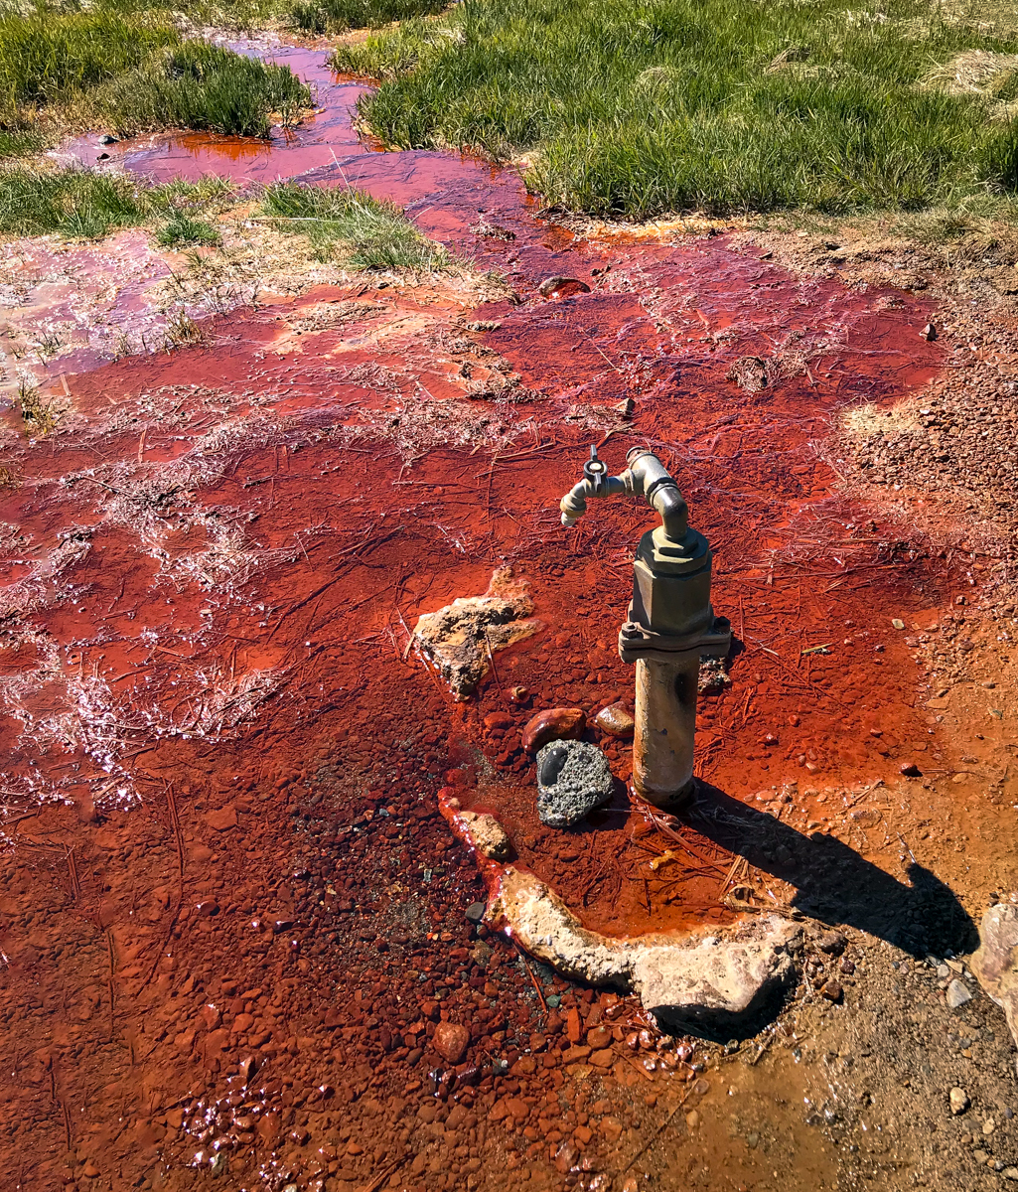
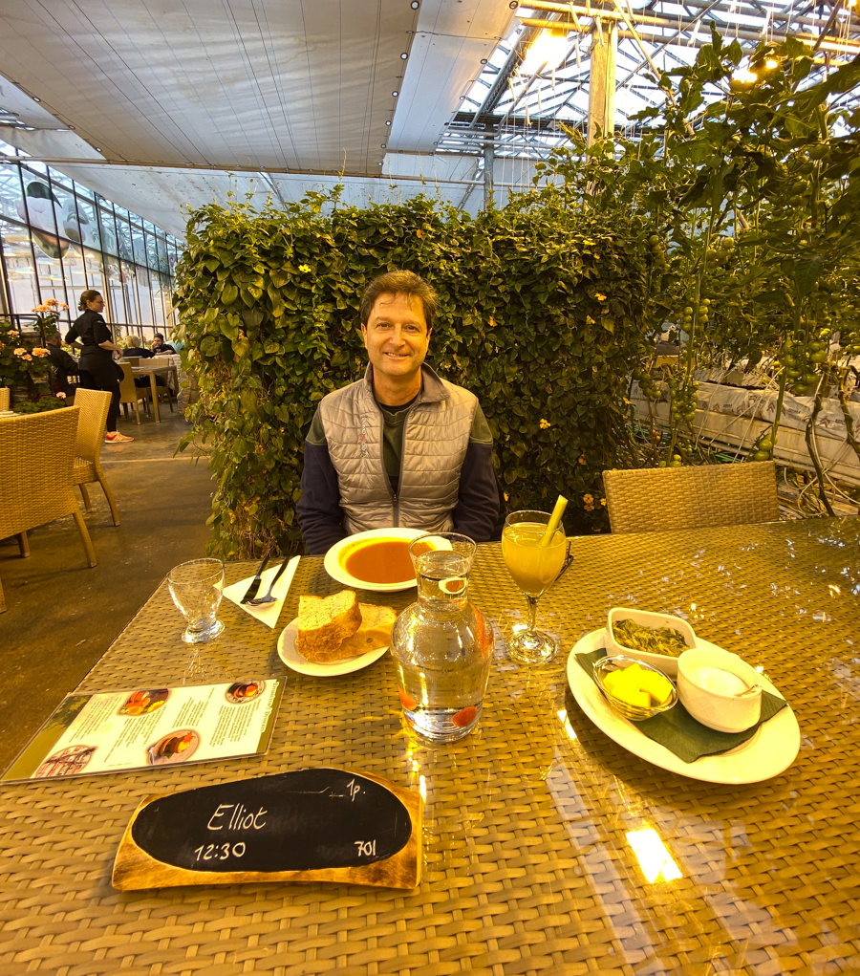
PRACTICALITIES
FOOD & DRINK
LODGING
SHOPPING
COSTS
Notes:
Iceland pleases in small as well as big ways. Farm to table.
Food: Friðheima
Booking.com fosshotel
Beer
Cost no fees

Slide 4
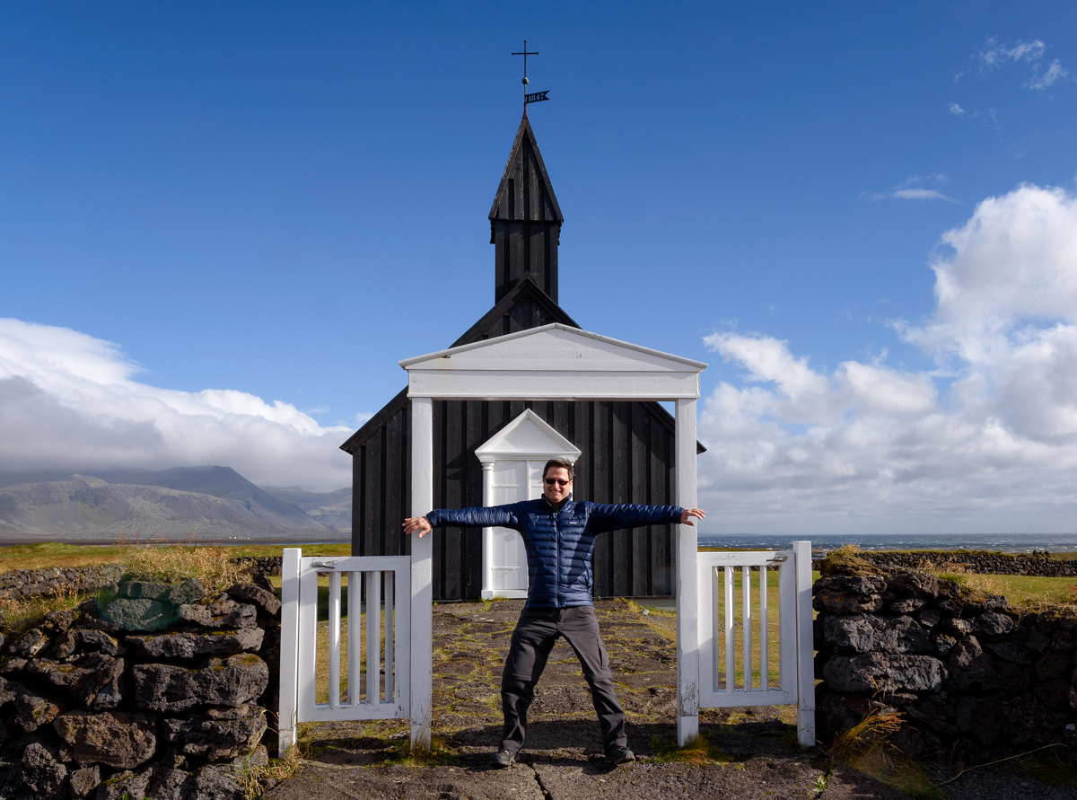
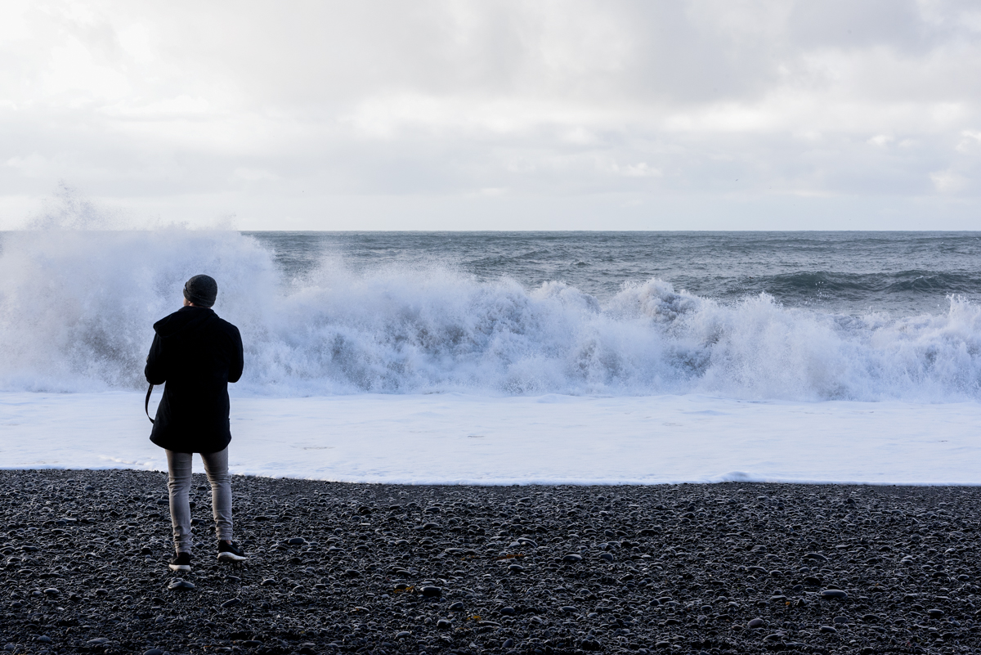
SAFETY
WEATHER / WHEN TO GO
DARWIN AWARDS
Notes:
If you don’t like our weather, wait 5 minutes
Work with the weather (foggy 2 days, great for birds and glacial hike) Bring weather proof gear. Prepare for everything, even in the summer.
Reyisfjara, Budir, photography the beach
Safest country in the world, but no park rangers to stop stupidity, driving (tourist van blown over), 2 of 3 trips had high winds

Slide 5
SAFETY
WEATHER / WHEN TO GO
DARWIN AWARDS
Notes:
Super jeep during a major storm

Slide 6
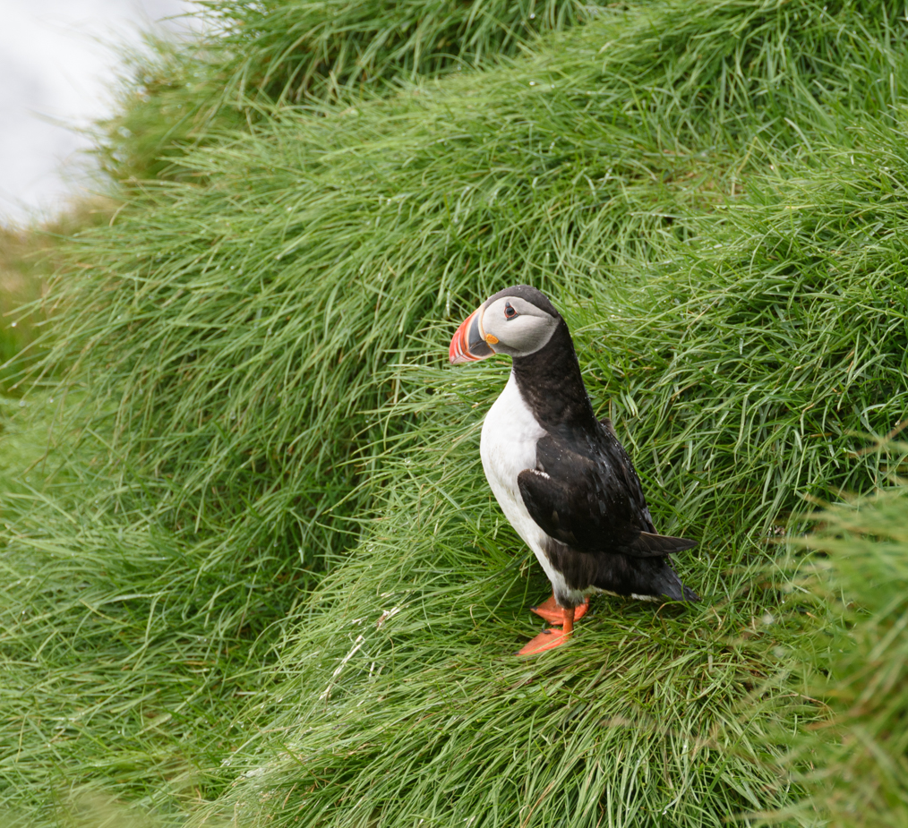
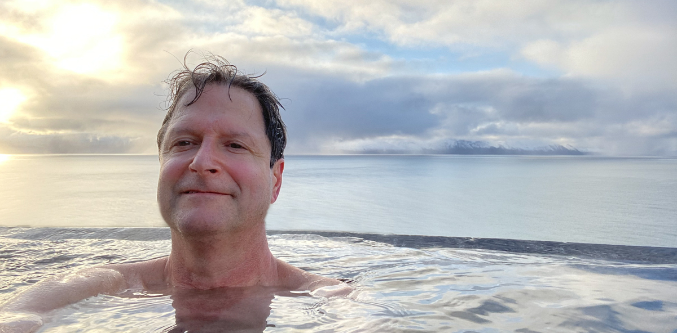
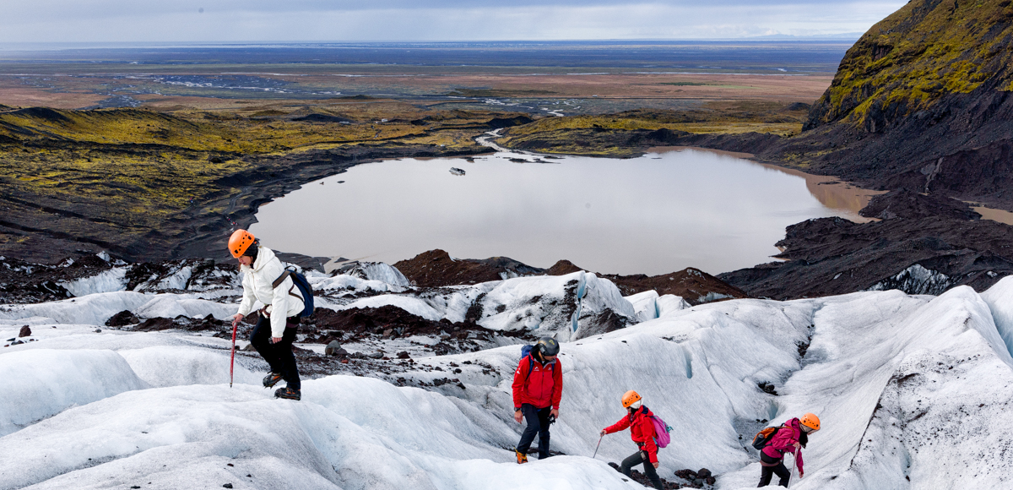
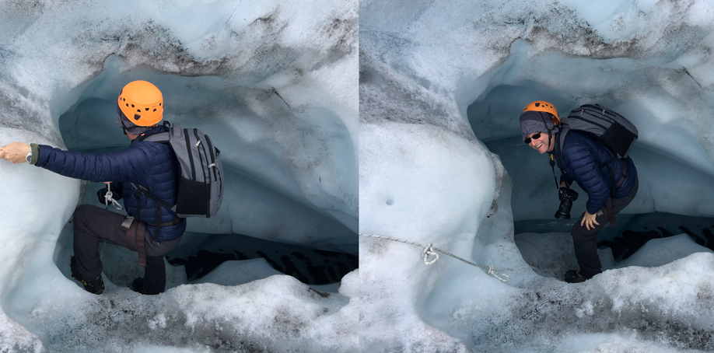
THINGS TO DO
DAY TOURS inc. PHOTO TOURS
GLACIER HIKES / ICE CLIMBING
CAVES ice and the regular kind
SNOWMOBILING
SNORKLING / SCUBA DIVING
SPAS / GEOTHERMAL SPRINGS
WILDLIFE (BIRDS, WHALES, FOXES, DEER, SEALS)
HORSERIDING
NORTHERN LIGHT CHASING

Slide 7
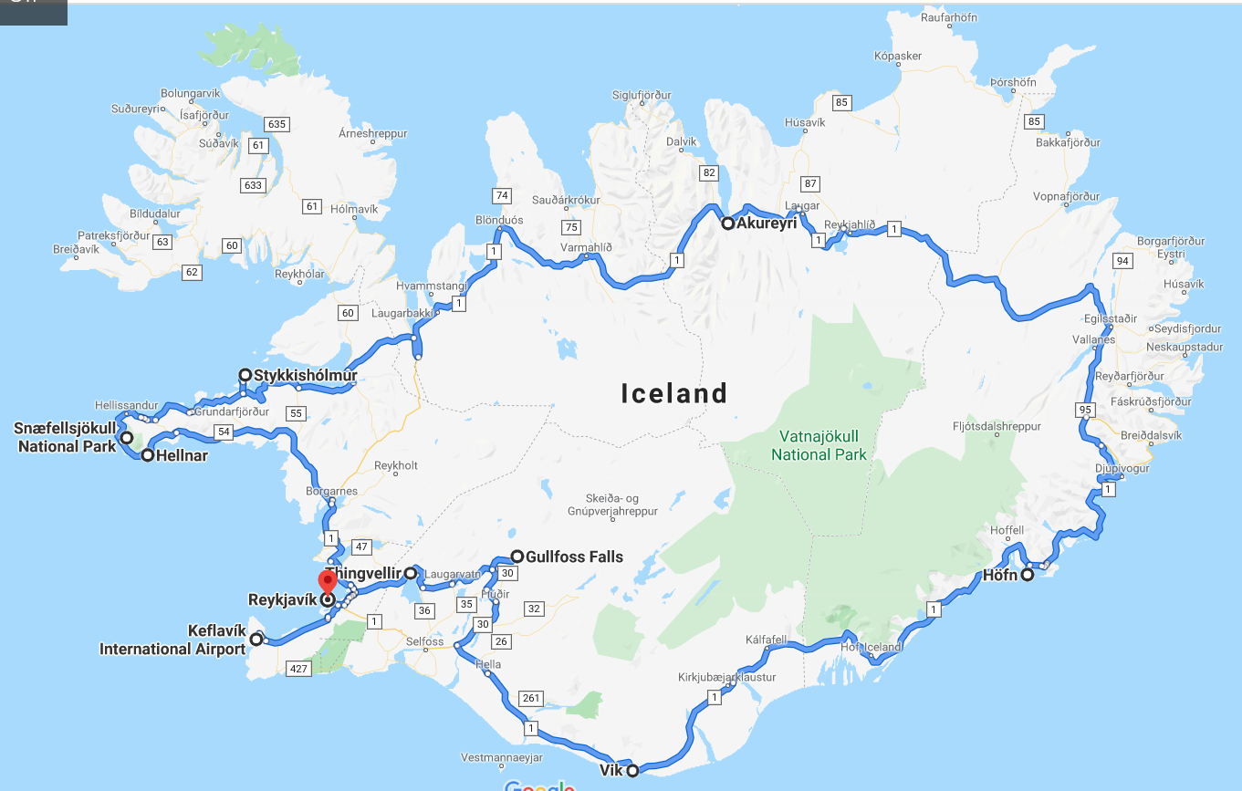
Take a Trip on the Beaten Track
Golden Circle
South / South East
East Fjords
The North
The West
and Off the Beaten Track
Notes:
Counter-clockwise: Golden circle/south and southeast: most touristed and tour buses. Short trip, focus on these.
Off beaten track: just off the highway to northern and western peninuslas and highlands

Slide 8
Relax

Slide 9
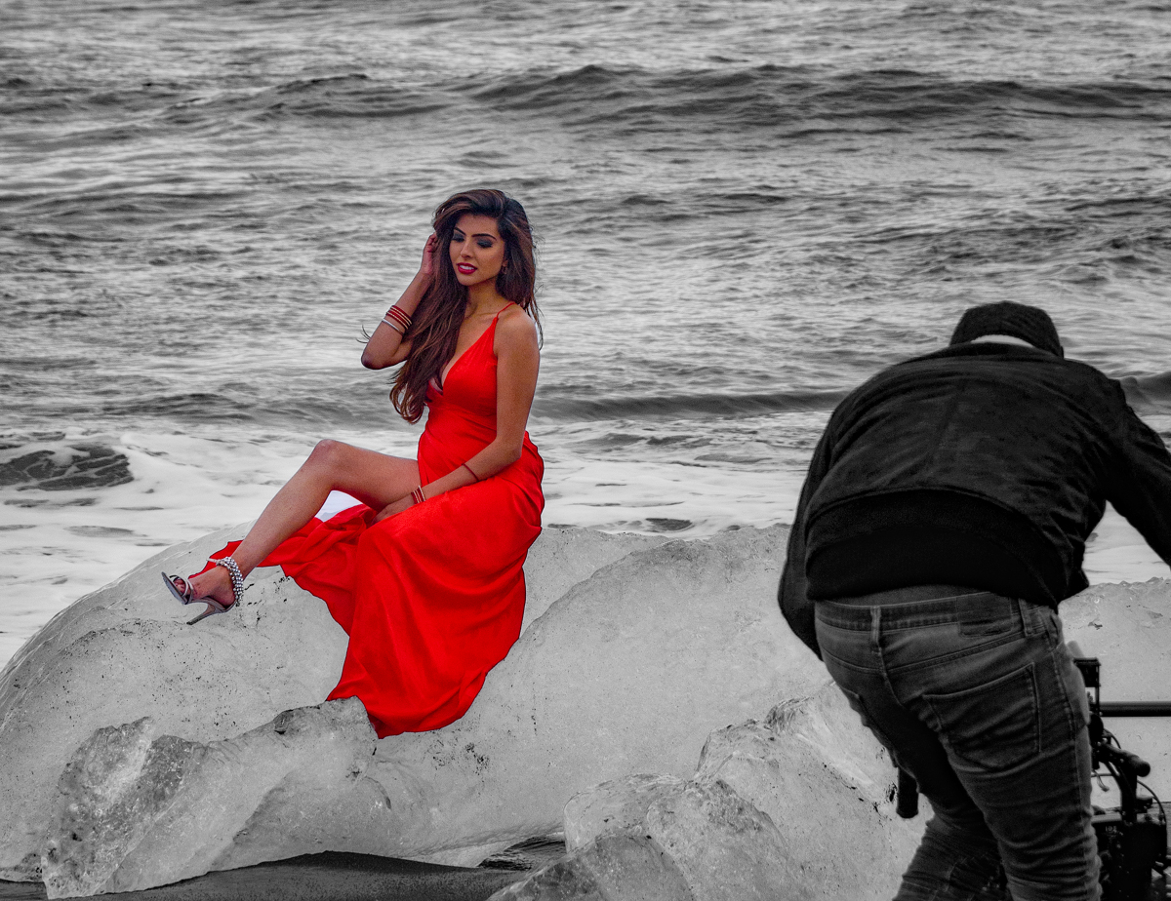
Have a seat

Slide 10
Take Your Bra Off

Slide 11
…and Enjoy the Ride
Driving while under the influence of photography

Slide 12
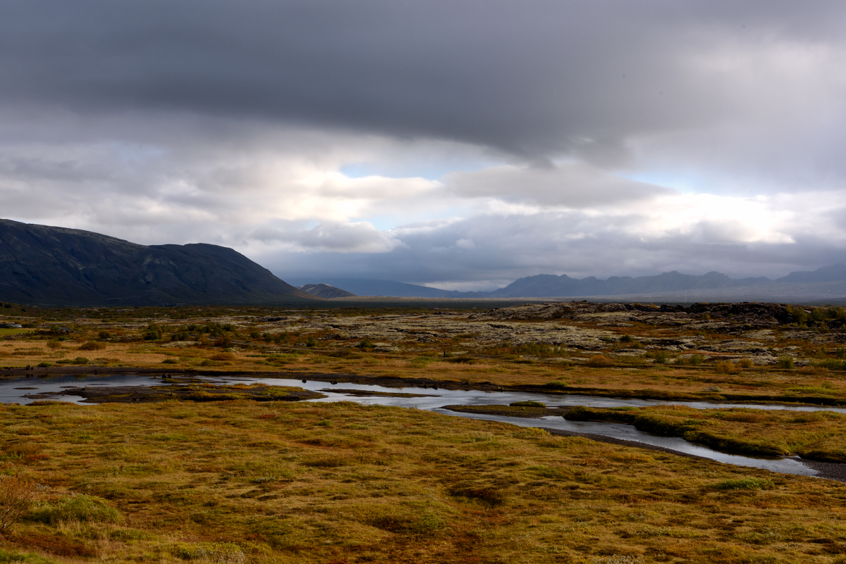
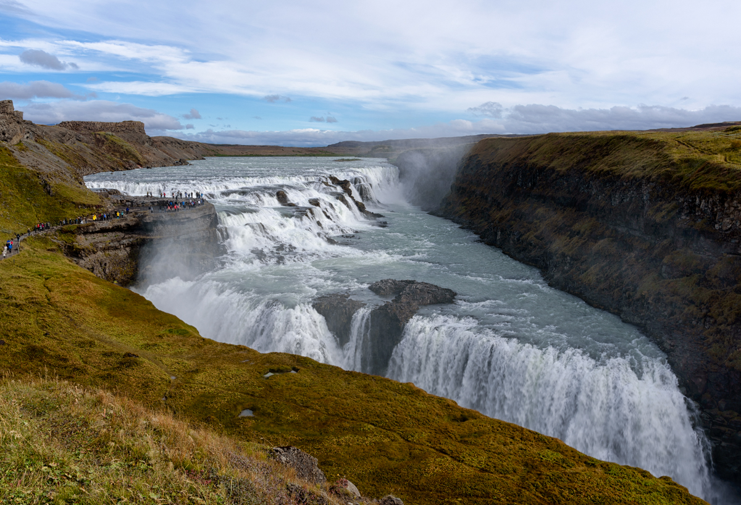
Golden Circle
Thingvellir national park/ Gulfoss / GeysIr (Strokkur)

Slide 13
“Hidden” Golden Circle
Bruarfoss
Notes:
“Hidden” - Nothing is hidden these days, but I rely on the laziness of people who don’t research, can’t be bothered to get there, or only want a selfie of the most popular spot.

Slide 14
“Hidden” Golden Circle
HAIFOSS & GJAIN VALLEY reykjadalur HOT RIVER KERIO KRATER Friðheima GREENHOUSE Homemade Ice Cream with cows

Slide 15
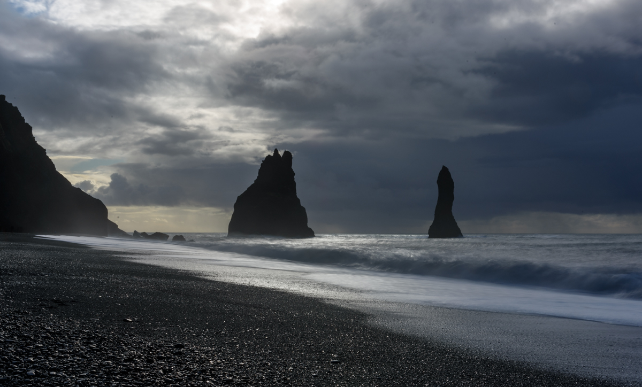
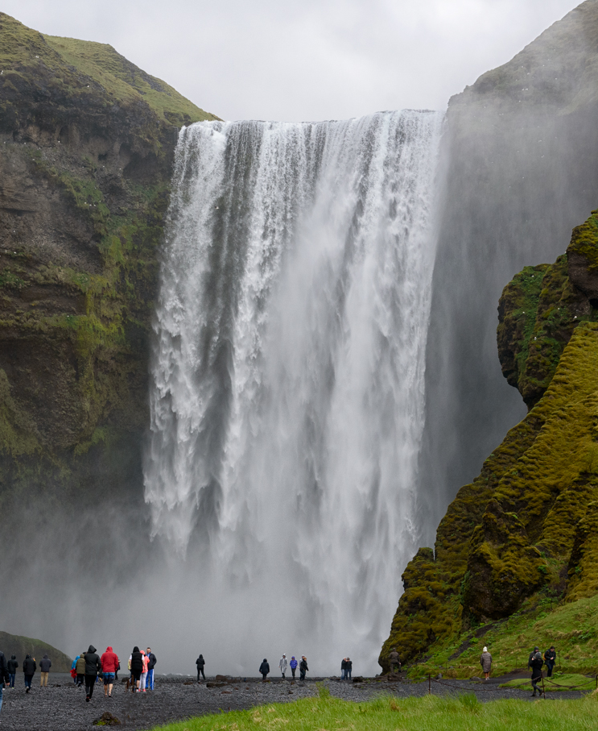
South
SejaLAnSFOSS / Skogafoss
DylRHoLAEY CAPE & ReynIsfJarA BLACK sand BEACH

Slide 16
Vik: the South’s Metropolis

Slide 17
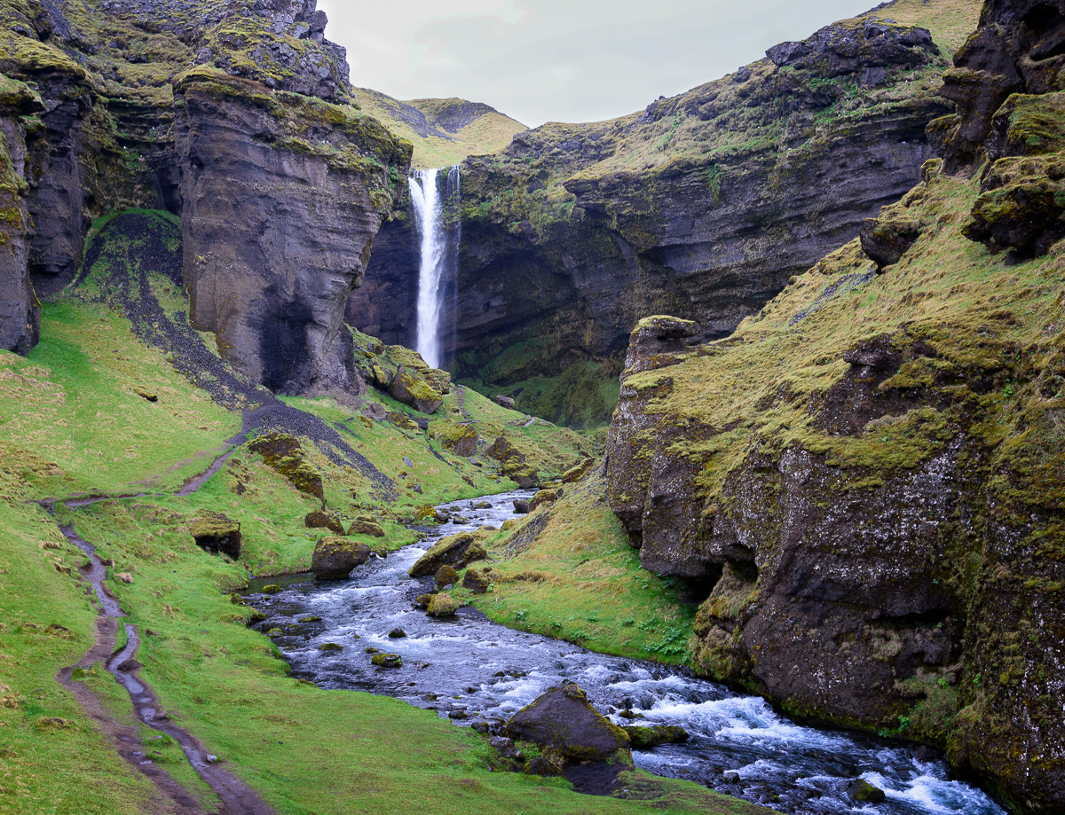
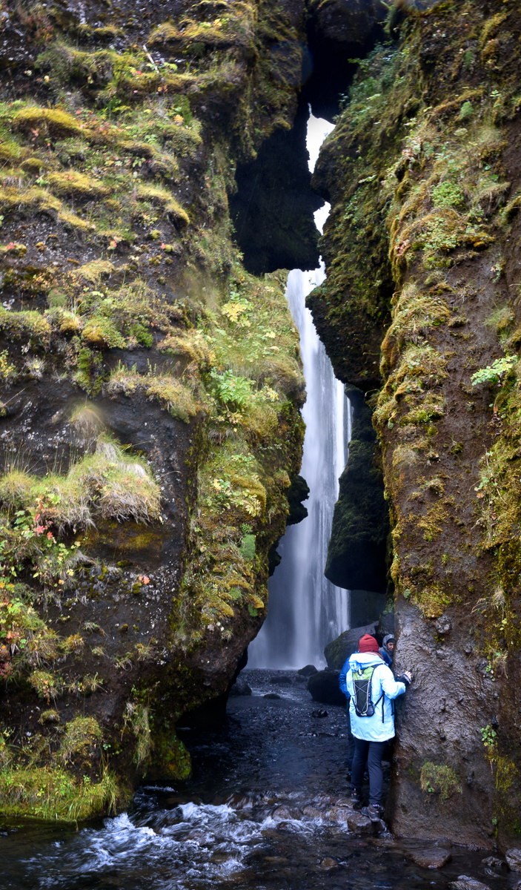
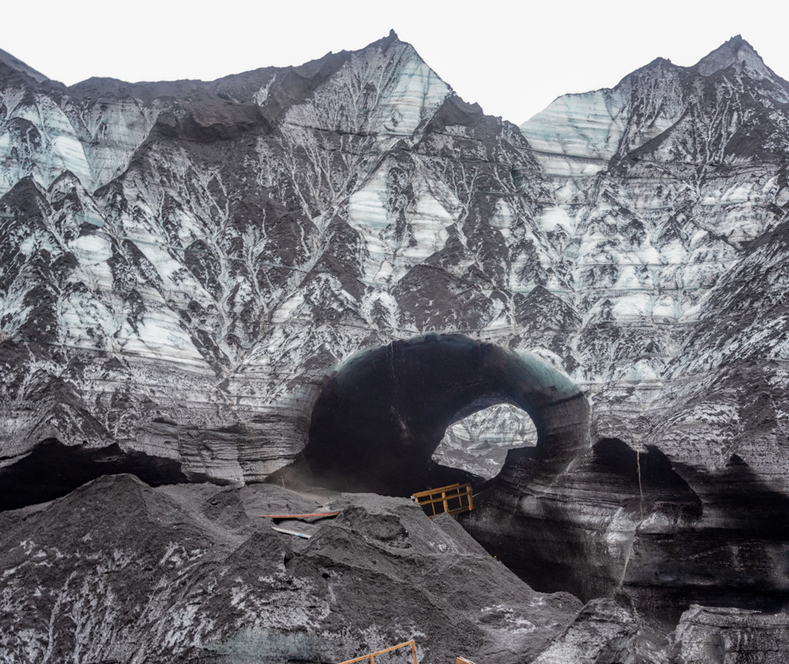
Hidden South
Katla SECRET ice cave SOLHEIMAJOKULL glacial lip SolheimASANDUR PLANE CRASH kvernufoss thorsmark hike
Notes:
Super jeep

Slide 18
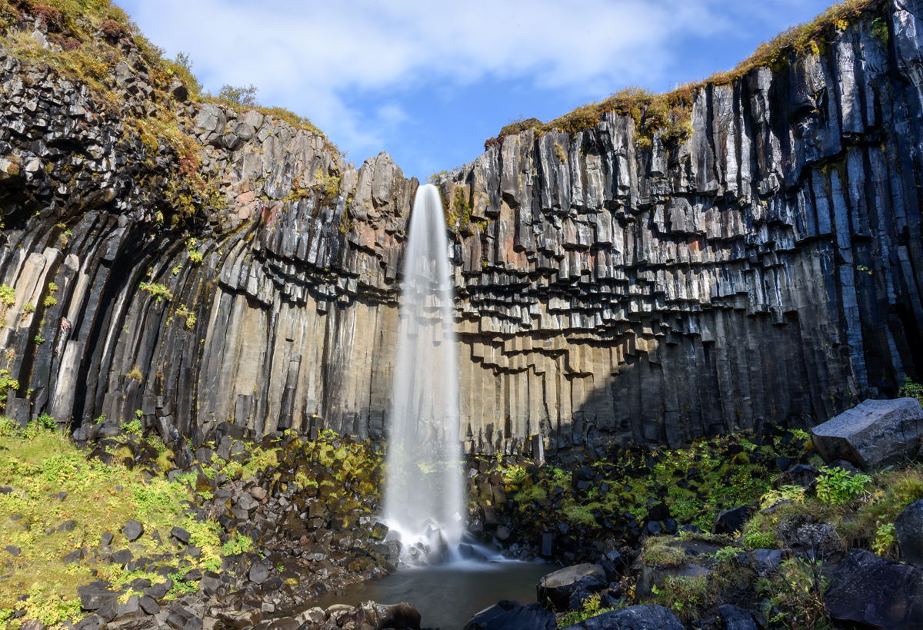
Southeast
Skaftafell (svartifoss) / jokulsarLon / diamond beach / vestrahorn

Slide 19
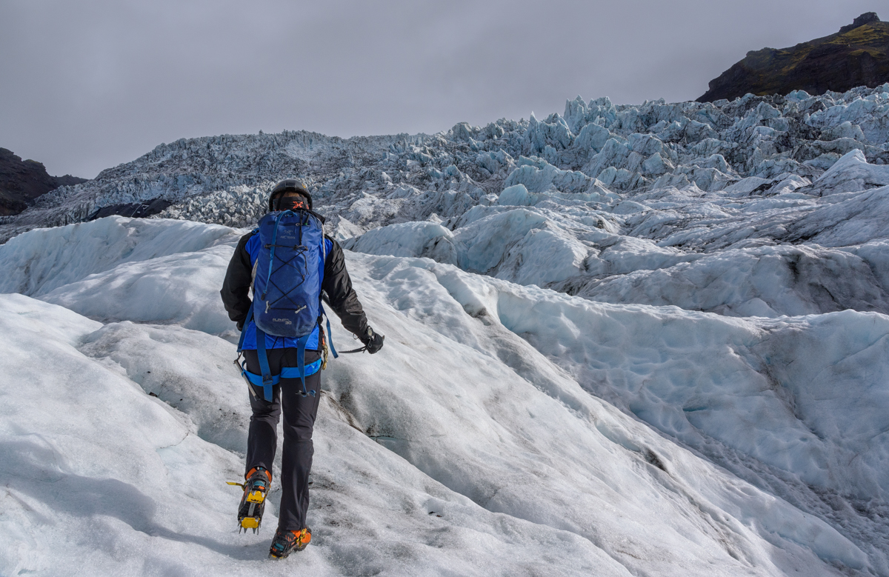
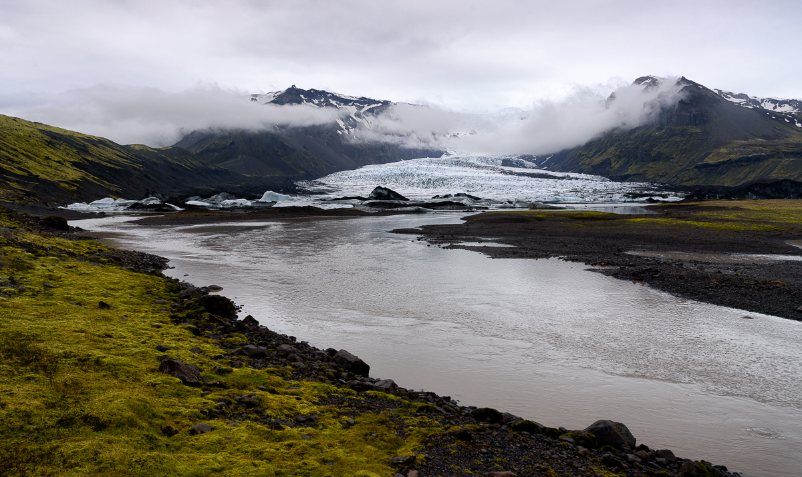
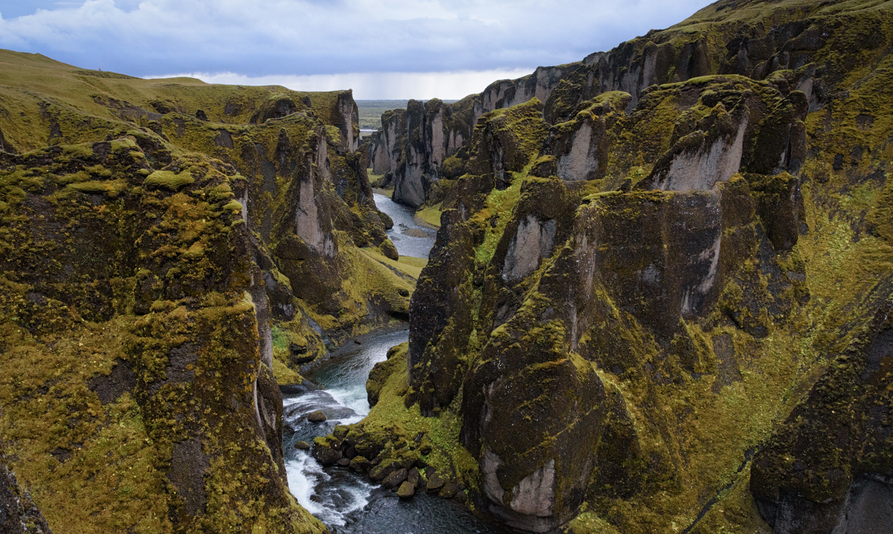
“Hidden” Southeast
Glacial hikes, secret glacial lips, ingolfshofdi BIRD WATCHING, Bieber canyon
Notes:
Each lip is unique. Picnic area and Fjallsarlon (can’t decide which is prettiest)

Slide 20
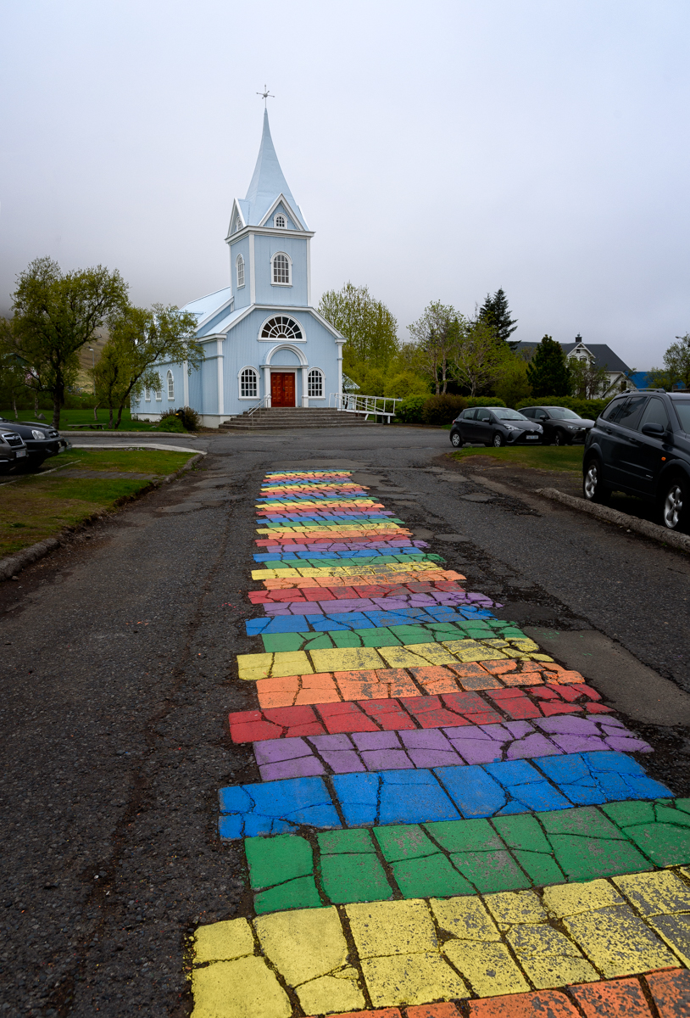
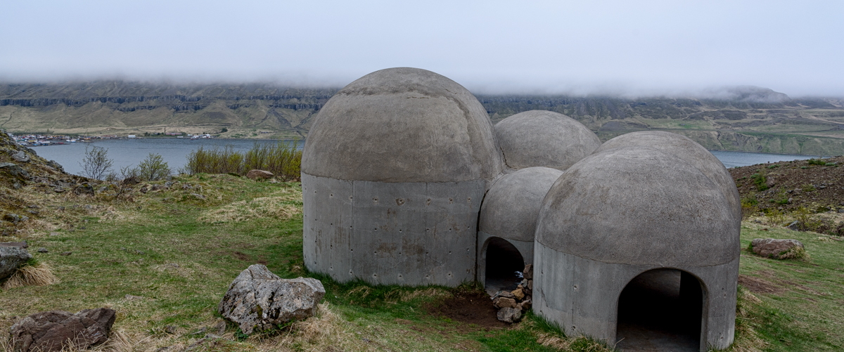
East Fjords
SeyDisfjordur / Tvisongur / studlagil canyon
Notes:
Five curved dome buildings based on the five notes of the Icelandic traditional music. Basalt columns

Slide 21
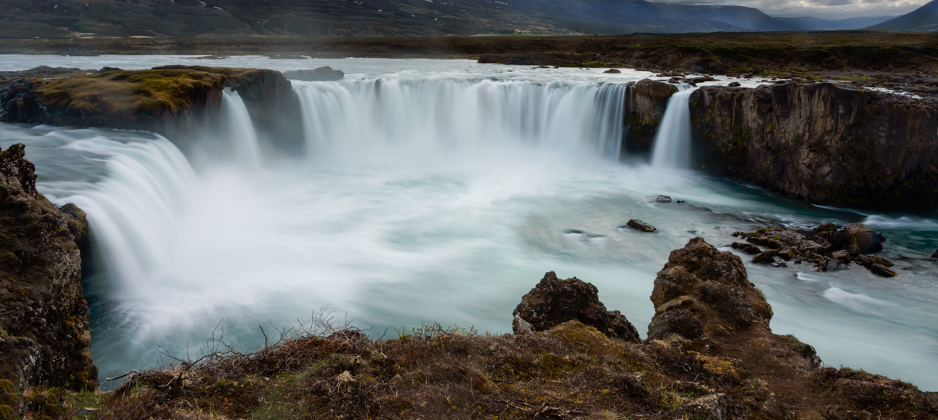
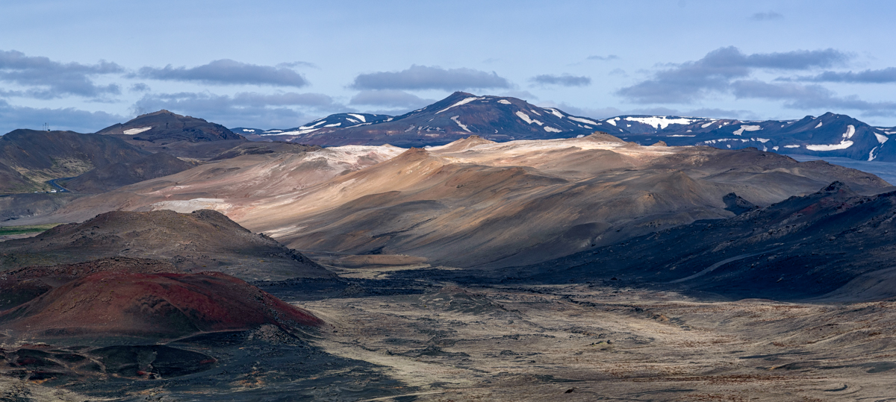
North
GODAFOSS
DETTIFOSS
MYVATN: KRAFLA / NAMAJFALL / HVERFJALL /
NATURE BATHS
AKUREYRI (CAPITOL OF THE NORTH)
Notes:
Earth is about to explode. Bubbling, gurgling hot pots, best alternative to the Blue Lagoon.

Slide 22
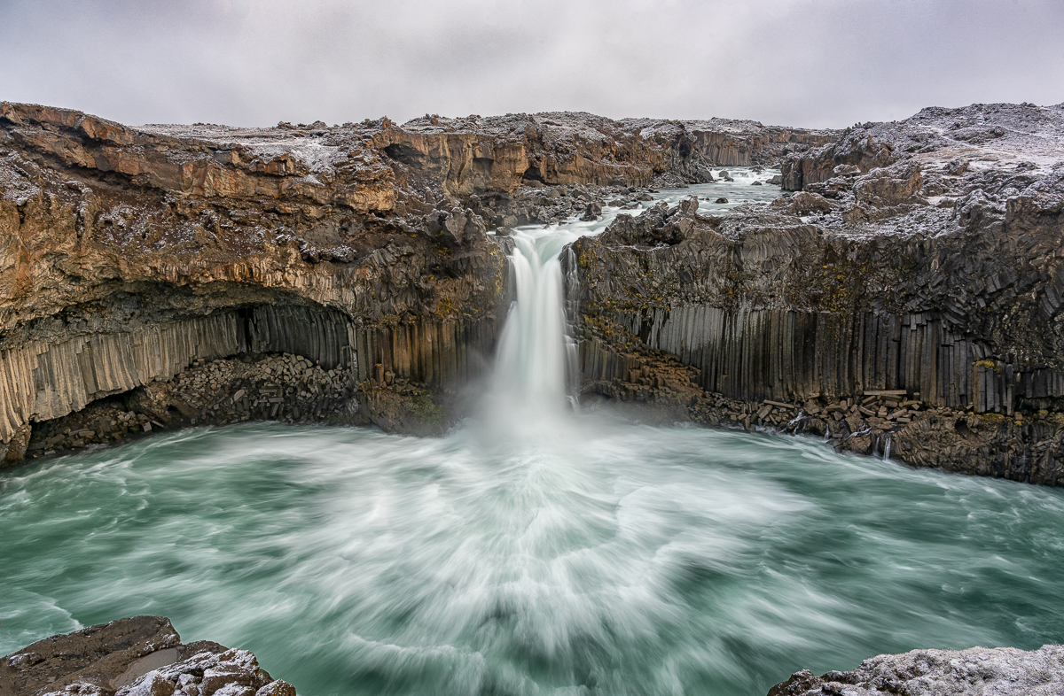
Hidden North
HIDDEN NORTH
Notes:
Aldeyjarfoss in the highlands

Slide 23
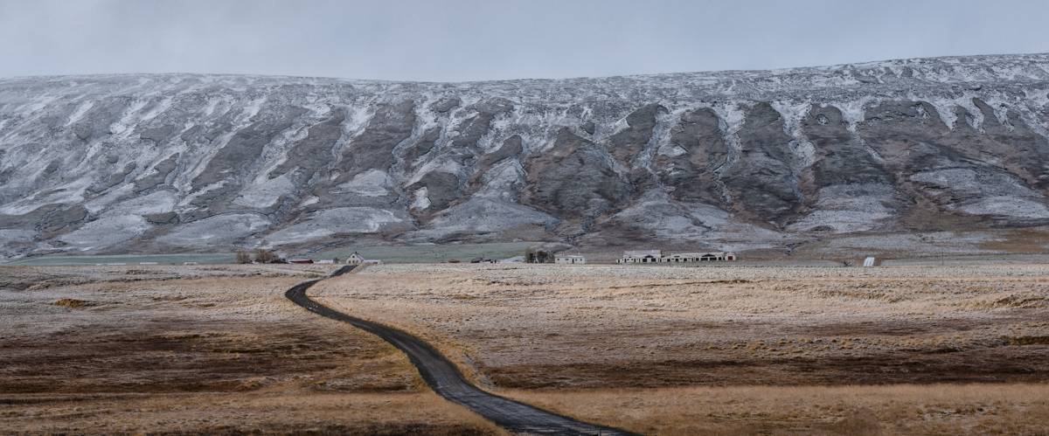
Hidden North
Aldeyjarfoss /Husavik COASTAL TOWN/ Asbyrgi PARK / hvitserkur rock

Slide 24
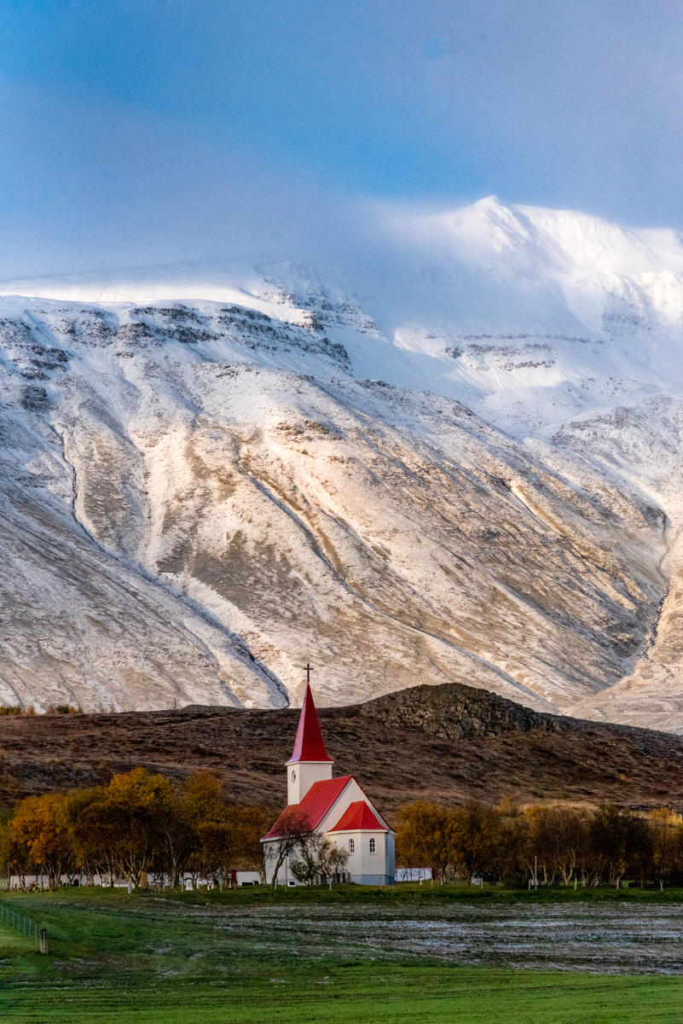
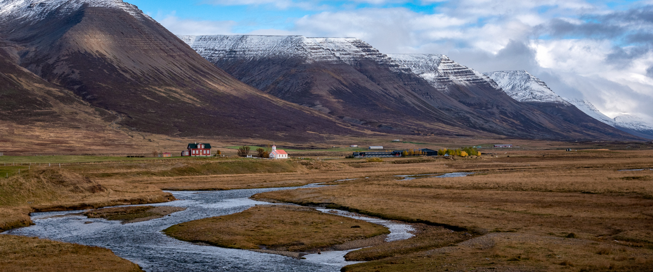
Hidden North
Trollaskagi peninsula: Siglufjordur / hofsos baths
Notes:
My favorite peninsulas, Grof turf church

Slide 25
The West
SNAEFELLSNES PENINUSLA: KIRKJUFELL GOT MOUNTAIN / SNAEFELLSNES NATIONAL PARK / BUDIR BLACK CHURCH / STYKKISHOLMUR COASTAL VILLAGE
Notes:
SECRET LIFE OF WALTER MITTY with ben stiller

Slide 26
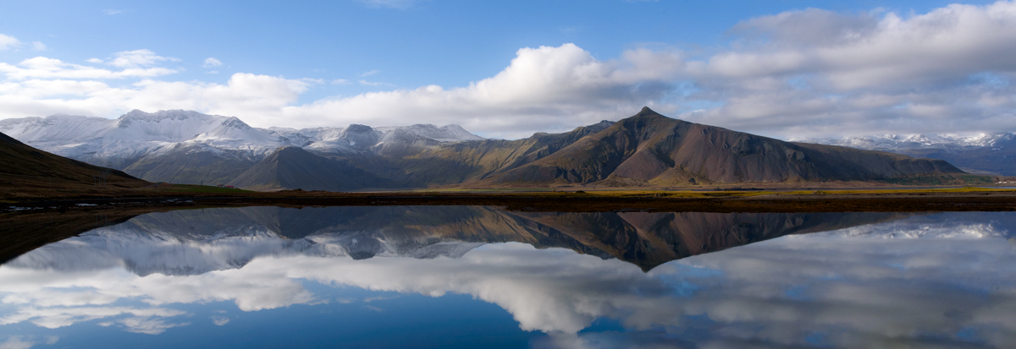
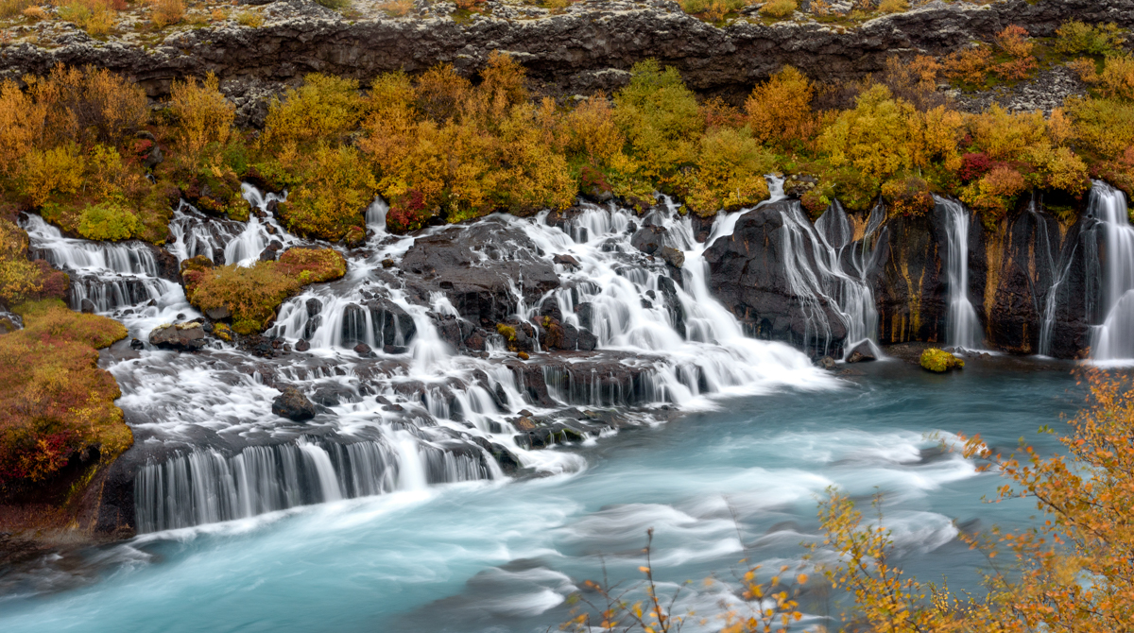
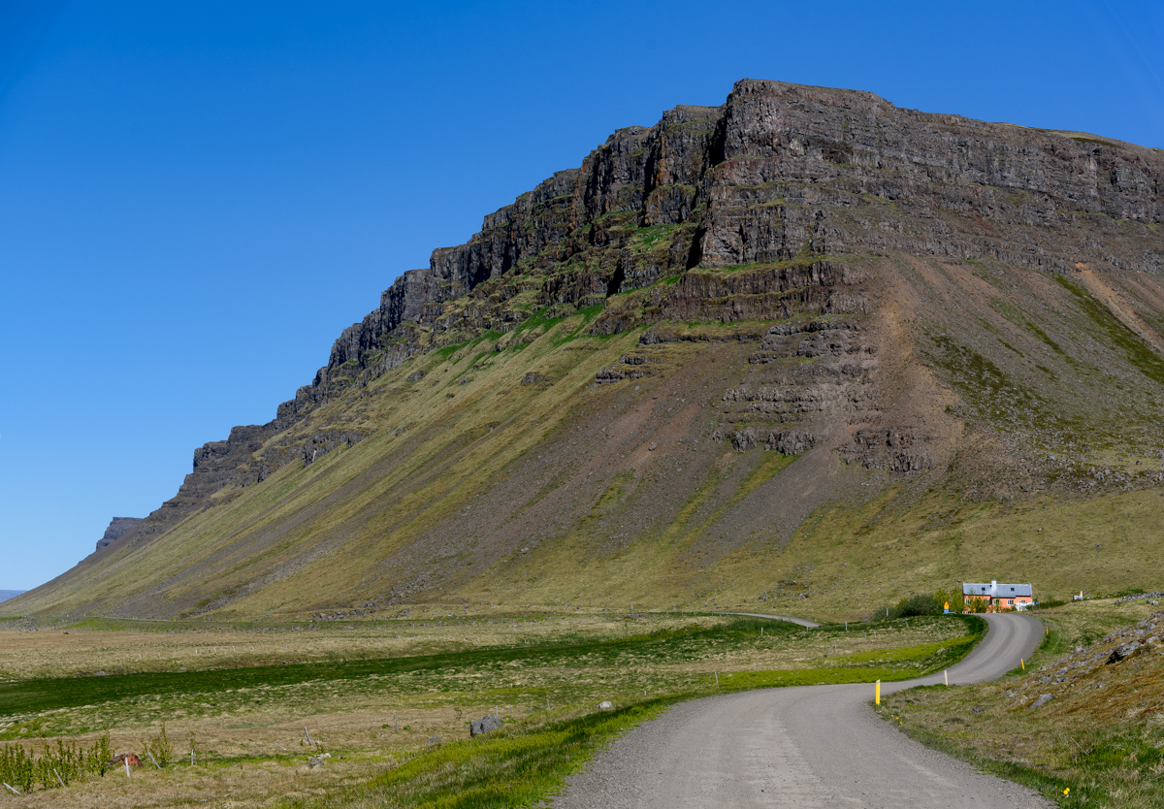
Hidden West
WEST FJORDS
BREIDAFJORDUR BAY
GURDUNARLAUG HOT POT
HUSAFELL
Notes:
How many tourists: 0

Slide 27
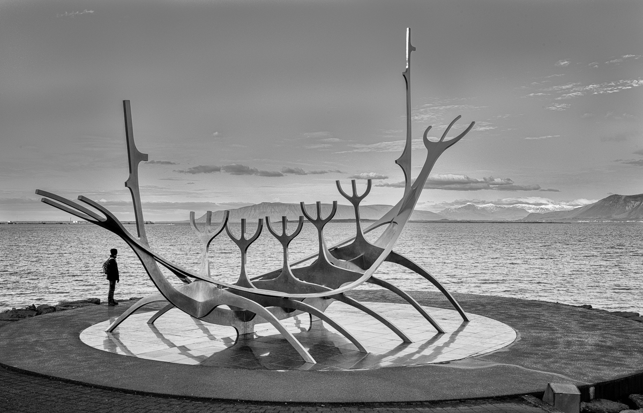
Reykjanes Peninsula
Reykjavik
Blue Lagoon

Slide 28
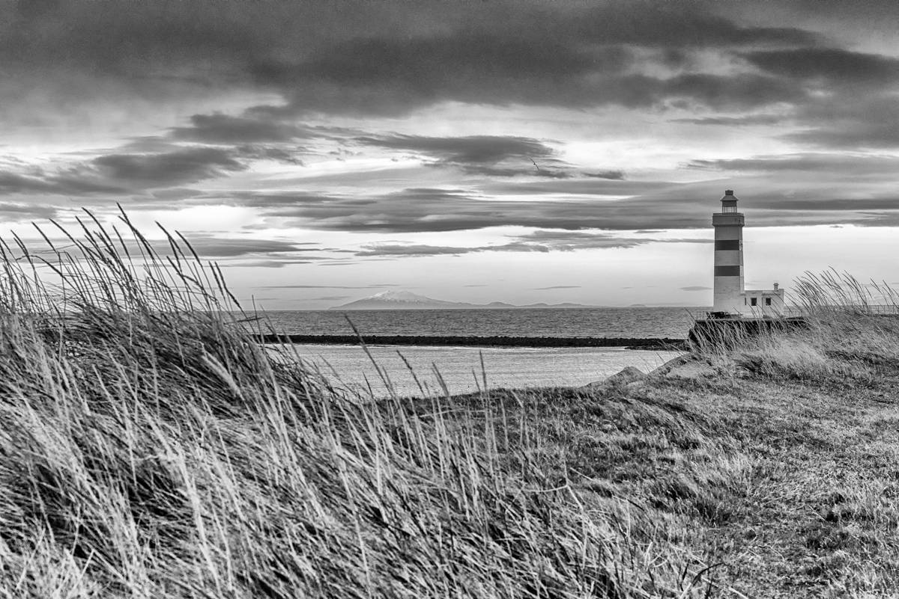
Hidden Reykjanes Peninsula
Gardur Lighthouse/ Seltun Geothermal area / Into the Volcano Tour / Birdwatching Cliffs
Notes:
Gardur Lighthouse, Seltun Geothermal area, “into the volcano”, Cliffs Ruined by Pearce Brosnan and Will Ferrell

Slide 29
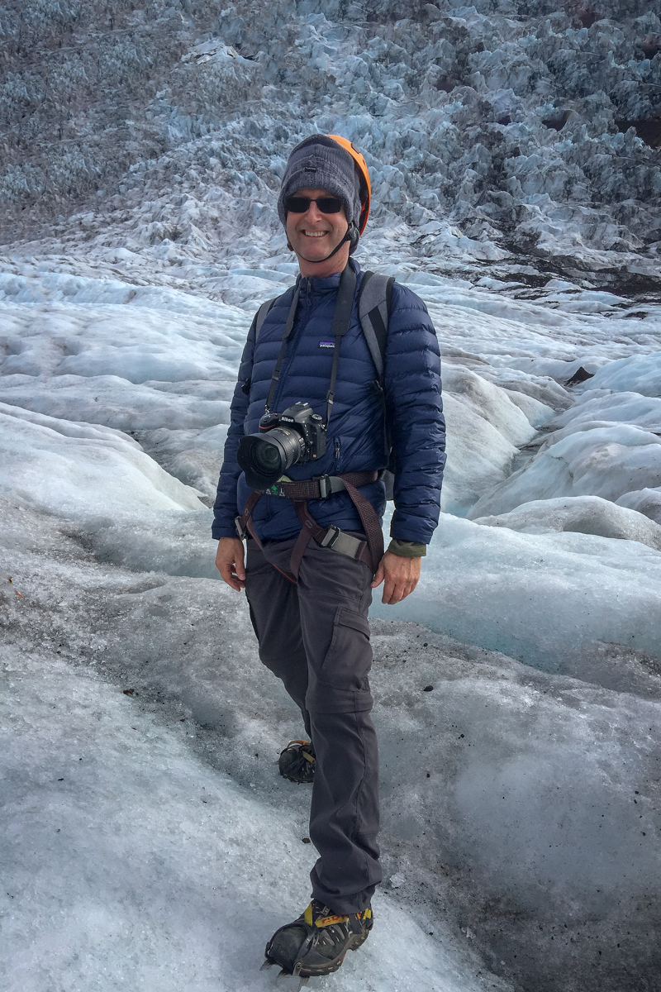
SOURCES OF INFO
Best travel guide: Bradt
International Photographer map <<international-photographer.com>>
Road conditions: <<road.is>>
Weather conditions: <<vedur.is>>
Photo Tours: Arctic Shots, Thor Photography
Overall best source: RCC members
photo: ruggedly handsome RCC member

